Slide 1
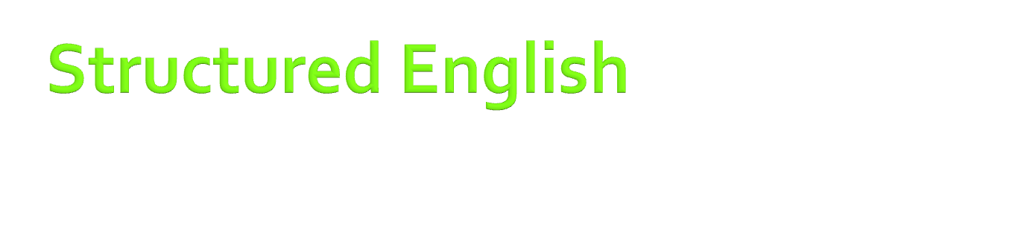
ABH,IEM

Slide 2

Structured English is a very limited, highly restricted subset of the English language used to plan, design, or document program routines, modules and helps in decision making procedure.

Slide 3

It resembles a programming language, so programmers find it easy to understand. The base for structured English is, of course, English, so users find it easy to follow, too.
Structured English is excellent for describing an algorithm, particularly when user communication is essential. If the main concern is communication with the programmers, however, pseudocode may be a better choice. Structured English is not a good choice for describing a high-level control structure or an algorithm in which numerous decisions must be made; logic flowcharts, decision tables, and decision trees are better for such tasks.

Slide 4

There are several variations of structured English, none of which can be considered a standard.
A good structured English statement- reads like a short imperative sentence. By convention, only key words such as IF, THEN, SO, REPEAT, UNTIL, DO, and so on are capitalized; data names and the general English needed to complete a sentence or a phrase are lower case.

Slide 5

Sequence
Blocks of logic
Decision or selection
Repetition or iteration

Slide 6
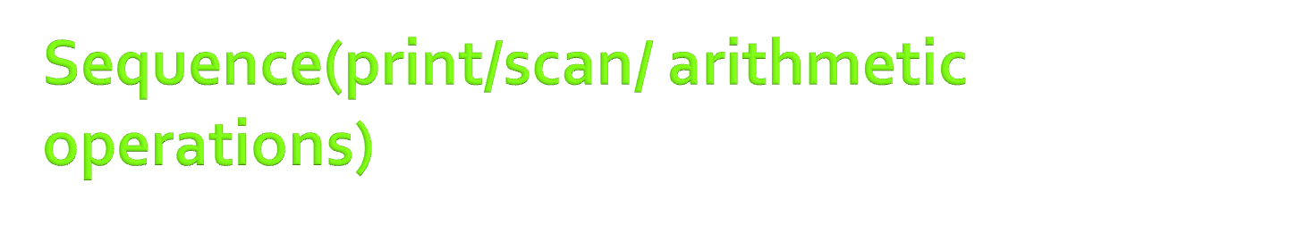
Sequence statements begin with commands such as MOVE, GET, WRITE, READ, or COMPUTE followed by the name or names of the associated data elements or data structures. For example,
COMPUTE gross pay.
ADD 1 to counter.
MULTIPLY hours worked by pay rate to get gross pay.
GET inventory record.

Slide 7

It is often convenient to group several structured English statements into a block, assign a name to the block, and reference the block by coding a single sequence statement. For example, all the instructions required to compute gross pay might be grouped in a block under the name compute gross pay. Subsequently, the statement
DO compute gross pay same as grosspay();

Slide 8

Decision (or selection) logic follows an IF-THEN-ELSE structure:
IF condition THEN block-1 ELSE (not condition) SO block-2.The key word IF is followed by a condition. If the condition is true, the block following THEN is executed. ELSE identifies the negative of the condition. SO precedes the block to be executed if the initial condition is false.

Slide 9
For example,
IF x is greater than y
THEN
PRINT x
ELSE
PRINT y
Nesting is also possible.

Slide 10

Repetitive (or iterative) logic defines that a block of structured English statement which is executed repetitively until a terminal condition is reached. For example, such instructions as:
REPEAT UNTIL condition-1
block-1

Slide 11
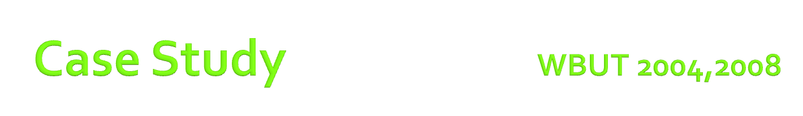
If order is from book store and if order is for 6 copies then discount is 25%.Else ( if order is for less than 6 copies) no discount is allowed. Else ,if order is from libraries and if order is for 50 copies or more then discount is 15%.Else if order is for 20 to 49 copies then discount is 10%. Else if order is for 6 to 19 copies then discount is 5%.Else (order is less than 6 copies) no discount is allowed.

Slide 12

If( )
{
}
else
{
if()
  {
    if ( )
    {
    }
    Else
    {
        If ( )
        {
        }
        Else
        {
        }
      }
  }
  }
IF customer is bookstore and order >6 copies
THEN get 25% discount
ELSE
  IF customer is library or individual
  THEN
    IF order >5 and <20
    THEN get 5% discount
    ELSE
      IF order >=20 and <=49
      THEN get 10% discount
      ELSE
        IF order >49
        THEN get 15 % discount

Slide 13



